Slide 1
Using Nextflow to manage, automate, and reproduce scientific workflows
Ashley Dederich, Ph.D.
Scientific Consultant
Center for High Performance Computing
University of Utah

Slide 2
Load Nextflow’s GitHub CodeSpaces:
https://training.nextflow.io/latest/hello_nextflow/

Slide 3
What is Nextflow?
Nextflow allows you to create simple, scalable, and reproducible scientific workflows.
Notes:
The business definition

Slide 4
What is Nextflow?
A powerful workflow manager for pre-built or custom data pipelines
Data pipelines built with Nextflow can…
  Access a variety of compute infrastructure (think: laptop, HPC, Cloud…)
  Automatically parallelize (can scale with demand)
  Automatically batch out your jobs (send jobs to Slurm)
  Increase scientific reproducibility (containerized = export your environment)

Slide 5
Why should you use Nextflow?
Data processing
with Nextflow
Data collection
Data analysis
Decrease time to data analysis

Slide 6
Nextflow is simple to use
$ nextflow run my_pipeline.nf
Notes:
I mean look how easy it is to run in the end:

Slide 7

Why should you use Nextflow?
Portable
Fast prototyping
Reproducible
Batch scheduling + parallelism
Organized I/O

Slide 8
Why should you use Nextflow?
Pre-built pipelines +
Simple pipeline definition
Portable
Fast prototyping
Reproducible
Batch scheduling + parallelism
Organized I/O
Straightforward configuration

Slide 9
Why should you use Nextflow?
Usable on local laptop, HPC, + Cloud
Portable
Fast prototyping
Reproducible
Batch scheduling + parallelism
Organized I/O
Support for different storage, container, and batch options

Slide 10
Why should you use Nextflow?
Portable
Fast prototyping
Reproducible
Batch scheduling + parallelism
Organized I/O
Containerized software – exact environment exported
Nextflow pipeline details exact steps taken

Slide 11
Why should you use Nextflow?
Portable
Fast prototyping
Reproducible
Batch scheduling + parallelism
Organized I/O
Support for most (if not all) batch schedulers
Data processed in parallel

Slide 12
Why should you use Nextflow?
Portable
Fast prototyping
Reproducible
Batch scheduling + parallelism
Organized I/O
Direct connection between input and output

Slide 13

Is Nextflow Easy to Learn?

Slide 14
Is Nextflow Easy to Learn?
Nearly 200 pre-built analysis pipelines, by subject: https://nf-co.re
Easy custom pipeline setup
Clear definition of step-by-step input, output, and command.
Simple configuration of resources
Containerized software = pre-built software environments

Slide 15
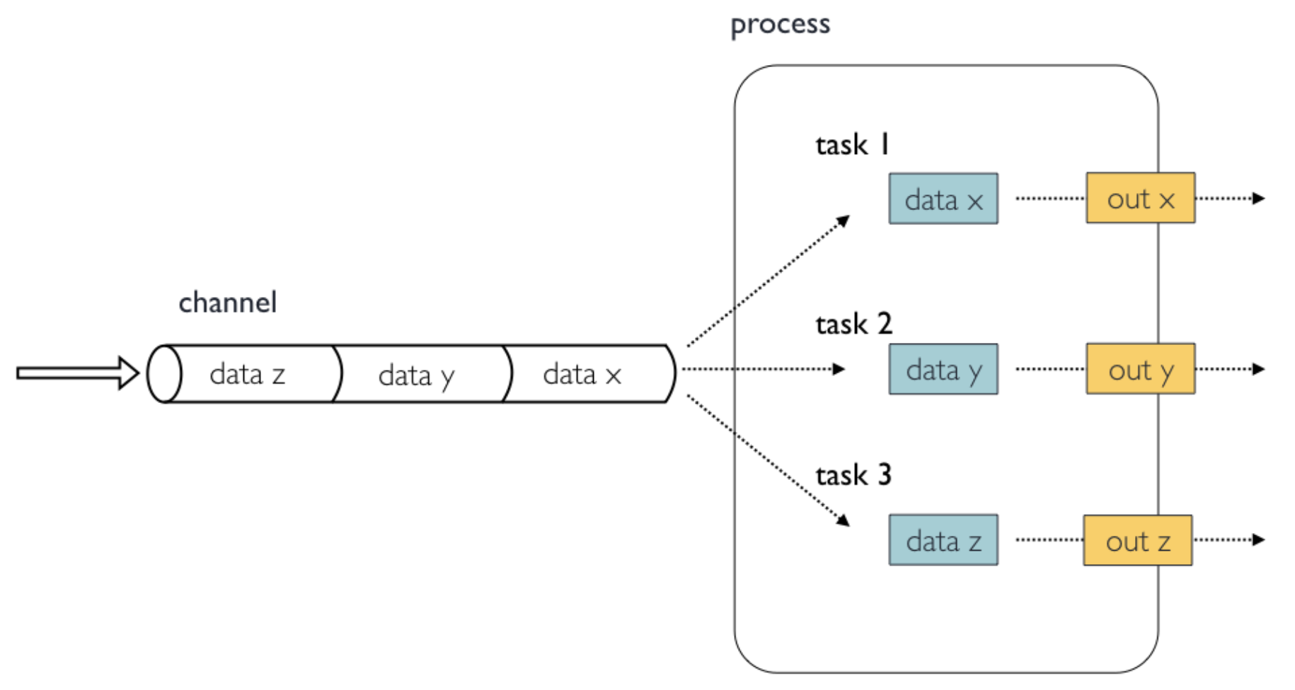
How Nextflow Works: my_nextflow_file.nf
Notes:
Input data thorugh a channel, give it to a task that manipulates the data in some way.
So we can give data x to task 1. task 1 does something to the data, and outputs x.

Slide 16
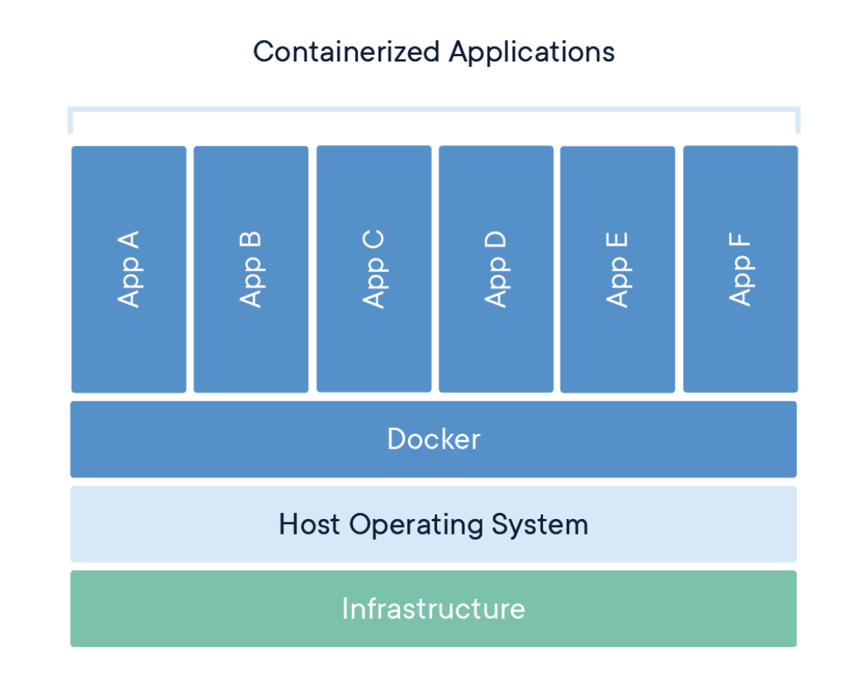
How Nextflow Works: Containers
Singularity
Notes:
A container is an virtualized computer within a computer: its really an inception moment.
It’s a great way to store version-controlled software that is useable across platforms

Slide 17
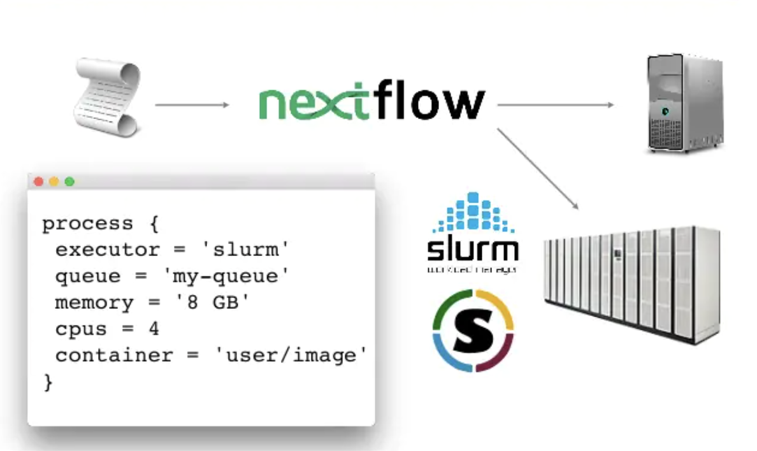
How Nextflow Works: Config Files
Notes:
A configuration file acts like a manager over nextflow: it asks your process file what it wants to do and with what contaienrs and then goes to the computer and says ‘hey I need you to do this stuff with this much memory and with these containers’

Slide 18
Load Nextflow’s GitHub CodeSpaces:
https://training.nextflow.io/latest/hello_nextflow/

Slide 19
Nextflow (.nf) Files

Slide 20
Input Data

Slide 21
Nextflow Files: Importing Data
FIRST give Nextflow some data to work with
Two ways:
  Parameters
  Channels

Slide 22
Nextflow Files: Importing Data
Parameters
  Import data
  Flexible
  Can be used more than once
  Can become channels
Channels
  Import data
  Not flexible
  Can only be used once
  The backbone of passing data between steps (processes)

Slide 23
Nextflow Files: Importing Data
Parameters
  Import data
  Flexible
  Can be used more than once
  Can become channels
Channels
  Import data
  Not flexible
  Can only be used once
  The backbone of passing data between steps (processes)
Notes:
The most important thing about channels is that they are the backbone of processes – they designate the steps of the process

Slide 24
Nextflow Files: Importing Data
Creating a parameter
Notes:
See how in the file path, I use double quotes

Slide 25
Nextflow Files: Importing Data
Creating a parameter
  Parameters can be file paths
  params.file=“/some/path/my_file.txt”
Notes:
See how in the file path, I use double quotes

Slide 26
Nextflow Files: Importing Data
Creating a parameter
  Parameters can be file paths
  params.file=“/some/path/my_file.txt”
  Parameters can be arguments
  params.reference=‘e_coli’
Notes:
I can set a reference genome.
See that I am using single quotes here instead

Slide 27
Nextflow Files: Importing Data
Creating a parameter
  Parameters can be file paths
  params.file=“/some/path/my_file.txt”
  Parameters can be arguments
  params.reference=‘e_coli’
$ nextflow run my_nextflow_file.nf --reference drosophila
Notes:
This can be changed when I run nextflow from the command line
Why this is useful will become more apparent when I show you channels and configuration files

Slide 28
Nextflow Files: Importing Data
Creating a parameter
  Parameters can be file paths
  params.file=“/some/path/my_file.txt”
  Parameters can be arguments
  params.reference=‘drosophila’
$ nextflow run my_nextflow_file.nf --reference drosophila
Notes:
This can be changed when I run nextflow from the command line
Why this is useful will become more apparent when I show you channels and configuration files

Slide 29
Nextflow Files: Importing Data
Channels
Notes:
Now looking at channels, channels can

Slide 30
Nextflow Files: Importing Data
Channels
  Hold our data
Notes:
Hold our data, and

Slide 31
Nextflow Files: Importing Data
Channels
  Hold our data
  Can be made from parameters
Notes:
Remember that parameters can become channels, but channels CANNOT become parameters
*maybe add in a graphic with a circle with a line over it?*

Slide 32
Nextflow Files: Importing Data
Data passed into channel
Channels
  Hold our data
  Can be made from parameters
  Pass data from one process to another
Process 1 input
Process 1 output
Process 2 input …
Notes:
So here we import data in a channel, which gets passed onto the input of process 1.
Something happens to that data, and it gets pushed into an output channel
That output channel then gets passed onto the input of the next process, and so on…

Slide 33
Nextflow Files: Importing Data
Channel Types

Slide 34
Nextflow Files: Importing Data
Channel Types
  Value Channel – only contains a single value, can be used multiple times.
Notes:
First is a value channel. It is one single value that can be read multiple times without consuming its content.
I haven’t used this much, so I’m not going to speak much more on it.

Slide 35
Nextflow Files: Importing Data
Channel Types
  Value Channel – only contains a single value, can be used multiple times.
  Queue Channel (main) – unidirectional, connects the output of one process to the input of another.
      Can only be used once.
Notes:
The second type is a queue channel.
This is the main channel type
It connects the output of one process to the input of another – why it is called a ‘queue’
Can only be used once – its value is ‘consumed’ after that
Note: you can break up channels into parts if you need to use the data more that once

Slide 36
Nextflow Files: Importing Data
Channels have operators. Ex’s:
  Channel.of()
Notes:
Channels have operators, much like python

Slide 37
Nextflow Files: Importing Data
Channels have operators. Ex’s:
  Channel.of()
  Channel.fromPath()
Notes:
Channels have operators, much like python

Slide 38
Nextflow Files: Importing Data
Channels have operators. Ex’s:
  Channel.of()
  Channel.fromPath()
  Channel.fromFilePairs()
Notes:
Channels have operators, much like python

Slide 39
Nextflow Files: Importing Data
Channels have operators. Ex’s:
  Channel.of()
  Channel.fromPath()
  Channel.fromFilePairs()
Channel ‘create’ command
Notes:
Channels have operators, much like python

Slide 40
Nextflow Files: Importing Data
Channels have operators. Ex’s:
  Channel.of()
  Channel.fromPath()
  Channel.fromFilePairs()
Channel ‘create’ command
Channel operator
Notes:
Here, you can see that the operator we are using is to create a File Pair Channel

Slide 41
Nextflow Files: Importing Data
Importing a file from a specified path
Notes:
So putting this in use, we can import a file from a specified path

Slide 42
Nextflow Files: Importing Data
Importing a file from a specified path
my_first_channel=Channel.fromPath(“/some/path/myfile.txt”)
Notes:
So here, I’m giving the absolute path to a file named myfile.txt

Slide 43
Nextflow Files: Importing Data
Importing file pairs (like forward and reverse sequencing reads)
file_pairs_ch=Channel.fromFilePairs(“/some/path/*_{R1,R2}.fastq”)
Notes:
You can also import file pairs
The tuple structure is important, and will become more apparent when we specify our input within a process

Slide 44
Nextflow Files: Importing Data
Importing file pairs (like forward and reverse sequencing reads)
wildcard
file_pairs_ch=Channel.fromFilePairs(“/some/path/*_{R1,R2}.fastq”)
Notes:
Here, I’m doing two things.
I’m first using a wildcard, which says that everything after the asterisk has to be exactly the same, but everything before it can be variable

Slide 45
Nextflow Files: Importing Data
Importing file pairs (like forward and reverse sequencing reads)
wildcard
file_pairs_ch=Channel.fromFilePairs(“/some/path/*_{R1,R2}.fastq”)
Common identifier
Notes:
And everything after it should be the ‘common identifier for those files
The tuple structure is important, and will become more apparent when we specify our input within a process

Slide 46
Nextflow Files: Importing Data
Importing file pairs (like forward and reverse sequencing reads)
Breaks file sets into tuples:
  Grouping key
  List of files
file_pairs_ch=Channel.fromFilePairs(“/some/path/*_{R1,R2}.fastq”)
Notes:
Same can be done for any file – you can create a sample ID and group them based off of identifiers

Slide 47
Nextflow Files: Importing Data
Importing file pairs (like forward and reverse sequencing reads)
Breaks file sets into tuples:
  Grouping key
  List of files
file_pairs_ch=Channel.fromFilePairs(“/some/path/*_{R1,R2}.fastq”)
EX: 4 files
SampleA_R1.fastq SampleB_R1.fastq
SampleA_R2.fastq SampleB_R2.fastq
Notes:
Same can be done for any file – you can create a sample ID and group them based off of identifiers

Slide 48
Nextflow Files: Importing Data
Importing file pairs (like forward and reverse sequencing reads)
Breaks file sets into tuples:
  Grouping key
  List of files
file_pairs_ch=Channel.fromFilePairs(“/some/path/*_{R1,R2}.fastq.gz”)
EX: 4 files
SampleA_R1.fastq SampleB_R1.fastq
SampleA_R2.fastq SampleB_R2.fastq
[SampleA, [/some/path/SampleA_R1.fastq, /some/path/SampleA_R2.fastq]]
[SampleB, [/some/path/SampleB_R1.fastq, /some/path/SampleB_R2.fastq]]
Notes:
This is what the tuple looks like when Nextflow reads it in.

Slide 49
Processes

Slide 50
Nextflow Files: Process Breakdown
Process: defines a step in your data workflow
Notes:
Processes are the building blocks of nextflow and are what define the tasks and what is being run
So now that we have imported our data into a channel, we now need to pass that onto a process

Slide 51
Nextflow Files: Process Breakdown
Process: defines a step in your data workflow
Made up of four parts:
  Declaratives (optional)
  Input
  Output (optional)
  Script
process my_process {
[optional declaratives]
input:
input_file.txt
output:
output_file.txt
script:
“””
cat input_file.txt > output_file.txt
”””
}
Notes:
Processes are the building blocks of nextflow and are what define the tasks and what is being run
So now that we have imported our data into a channel, we now need to pass that onto a process

Slide 52
Nextflow Files: Process Breakdown
Process: defines a step in your data workflow
Made up of four parts:
  Declaratives (optional)
  Input
  Output (optional)
  Script
process my_process {
[optional declaratives]
input:
input_file.txt
output:
output_file.txt
script:
“””
cat input_file.txt > output_file.txt
”””
}
Notes:
Processes are the building blocks of nextflow and are what define the tasks and what is being run
So now that we have imported our data into a channel, we now need to pass that onto a process

Slide 53
Nextflow Files: Process Breakdown
Process: defines a step in your data workflow
Made up of four parts:
  Declaratives (optional)
  Input
  Output (optional)
  Script
process my_process {
[optional declaratives]
input:
input_file.txt
output:
output_file.txt
script:
“””
cat input_file.txt > output_file.txt
”””
}
Notes:
Processes are the building blocks of nextflow and are what define the tasks and what is being run
So now that we have imported our data into a channel, we now need to pass that onto a process

Slide 54
Nextflow Files: Process Breakdown
Process: defines a step in your data workflow
Made up of four parts:
  Declaratives (optional)
  Input
  Output (optional)
  Script
process my_process {
[optional declaratives]
input:
input_file.txt
output:
output_file.txt
script:
“””
cat input_file.txt > output_file.txt
”””
}
Notes:
Processes are the building blocks of nextflow and are what define the tasks and what is being run
So now that we have imported our data into a channel, we now need to pass that onto a process

Slide 55
Nextflow Files: Process Breakdown
Process: defines a step in your data workflow
Made up of four parts:
  Declaratives (optional)
  Input
  Output (optional)
  Script
process my_process {
[optional declaratives]
input:
input_file.txt
output:
output_file.txt
script:
“””
cat input_file.txt > output_file.txt
”””
}
Notes:
Processes are the building blocks of nextflow and are what define the tasks and what is being run
So now that we have imported our data into a channel, we now need to pass that onto a process

Slide 56
Nextflow Files: Process Breakdown
Process: defines a step in your data workflow
A Nextflow .nf file might define several steps, or processes
process TRIMFASTQFILES{
}
process PAIRFASTQFILES{
}
process ALIGNTOREFERENCE{
}
PROBLEM:
1) What order are these steps in?
2) What process do I pass my input data to, and what is the output from all the processes/steps?
SOLUTION:
A workflow definition
Notes:
In this example workflow, there might be 3 steps in a common bioinformatics workflow, where each step is defined like this.
However, we now have a problem: what order do these steps go in, and where do I pass my input data to?
This might seem obvious to you, but you need to define this for a Nextflow pipeline to run smoothly. This is

Slide 57
Nextflow Files: Process Breakdown
Process: defines a step in your data workflow
A Nextflow .nf file might define several steps, or processes
process TRIMFASTQFILES{
}
process PAIRFASTQFILES{
}
process ALIGNTOREFERENCE{
}
workflow {
input_ch=Channel.fromPath(“/some/path/*_{R1,R2}_001.fastq.gz”)
trimmed_files_ch=TRIMFASTQFILES(input_ch)
paired_files_ch=PAIRFASTQFILES(trimmed_files_ch)
aligned_files_ch=ALIGNTOREFERENCE(paired_files_ch)
}
Notes:
In this example workflow, there might be 3 steps in a common bioinformatics workflow, where each step is defined like this.
However, we now have a problem: what order do these steps go in, and where do I pass my input data to?
This might seem obvious to you, but you need to define this for a Nextflow pipeline to run smoothly. This is

Slide 58
Processes: Input and Output
Notes:
Note that this is different from importing data – importing data is giving your files to nextflow to begin with.
Inputting data is the data that you push into a process

Slide 59
Processes: Input
Your input takes data from a channel and passes it into a process.
process my_process {
[optional declaratives]
input:
path ‘input_file.txt’
output:
path ‘output_file.txt’
script:
“””
cat input_file.txt > output_file.txt
”””
}
Notes:
First taking a look at input:
The role of your input is to take data from a channel and give it to the process it is within

Slide 60
Processes: Output
Your output takes data from a process and passes it into a channel (opposite of input).
process my_process {
[optional declaratives]
input:
path ‘input_file.txt’
output:
path ‘output_file.txt’
script:
“””
cat input_file.txt > output_file.txt
”””
}
output file called here gets passed to channel
Notes:
Output called here is directly tied to the way that output is described in the script section

Slide 61
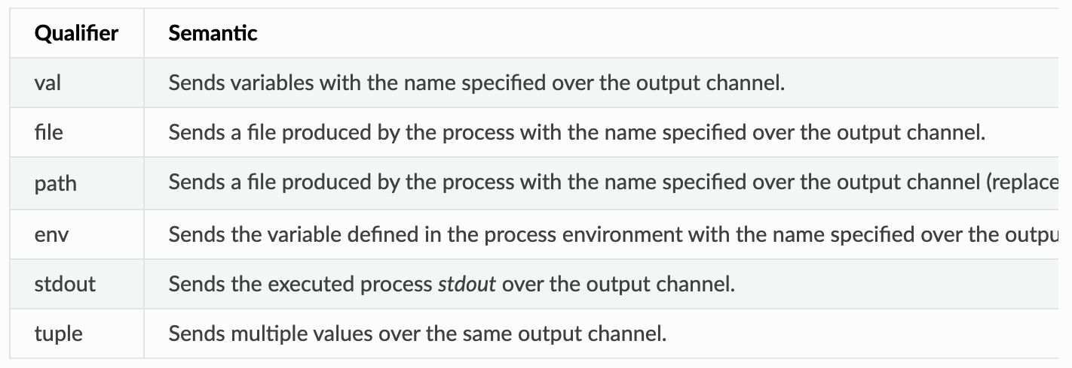
Process: Input/Output Types
Notes:
You have many ways that you can input data, here are all the different types of data you can input into a process
These are the two that I find most common to use
We will discuss most in depth

Slide 62
Process: Nextflow Data Types
Val – a value passed to channel with a specific name
process basicExample {
input:
val x
script:
“””
echo ‘process job $x’
“””
}
workflow {
num = Channel.from( 1, 2, 3 )
basicExample(num)
}
process job 3
process job 1
process job 2
Output printed:
Notes:
There are different input types.
You can have an input of generic values
So here, we have created a channel called ‘num’ that contains 3 values: the numbers 1, 2, and 3
Nextflow reads in that data as ‘val x from num’
This syntax is an important part of importing and exporting data, as it specifies the type of data and what you are calling it. The sytax can be broken down like such:

Slide 63
Process: Nextflow Data Types
Val – a value passed to channel with a specific name
process basicExample {
input:
val x
script:
“””
echo ‘process job $x’
“””
}
workflow {
num = Channel.from( 1, 2, 3 )
basicExample(num)
}
process job 3
process job 1
process job 2
input qualifer
Output printed:
Notes:
There are different input types.
You can have an input of generic values
So here, we have created a channel called ‘num’ that contains 3 values: the numbers 1, 2, and 3
Nextflow reads in that data as ‘val x from num’
This syntax is an important part of importing and exporting data, as it specifies the type of data and what you are calling it. The sytax can be broken down like such:

Slide 64
Process: Nextflow Data Types
Val – a value passed to channel with a specific name
process basicExample {
input:
val x
script:
“””
echo ‘process job $x’
“””
}
workflow {
num = Channel.from( 1, 2, 3 )
basicExample(num)
}
process job 3
process job 1
process job 2
variable name
input qualifer
Output printed:
Notes:
There are different input types.
You can have an input of generic values
So here, we have created a channel called ‘num’ that contains 3 values: the numbers 1, 2, and 3
Nextflow reads in that data as ‘val x from num’
This syntax is an important part of importing and exporting data, as it specifies the type of data and what you are calling it. The sytax can be broken down like such:

Slide 65
Process: Nextflow Data Types
File – a filename within a channel with a given name
process basicExample {
input:
file query_file
output:
file blastp.txt
script:
“””
blastp –query $query_file –db nr –out blastp.txt
“””
}
workflow {
proteins=Channel.fromPath(“/some/path/*.fa”)
basicExample(proteins)
}
Given file name
File defined in workflow
Notes:
So now, taking this syntax to other data types…
We can also import files into a process.
The syntax is the same, you just call it the input file type as ‘file’

Slide 66
Process: Nextflow Data Types
Tuples and Dynamic Input File Names
  Tuples can generate unique identifiers for file groupings, such as “sampleid” given here
process basicExample {
input:
tuple val(sampleid), file(reads)
output:
tuple val(sampleid), file(“${sampleid}_output.html”)
script:
“””
fastqc $reads > ${sampleid}_output.html
“””
}
workflow {
reads_ch=(“/some/path/*.fastq”)
basicExample(reads_ch)
}
You have two data types:
A Value (the sampleid)
A File (the defined file name)
Val
EX: 2 files
SampleA.fastq
SampleB.fastq
fastqc SampleA.fastq > SampleA_output.html
fastqc SampleB.fastq > SampleB_output.html
File
Notes:
You can also import tuples
The same as before, creates a tuple structure.

Slide 67
Processes: Script

Slide 68
Process: Script
Define your base language in a shebang
  Goes on first line of .nf file
Notes:
The first thing you want to put on your nextflow process file is a shebang
This is standard for any executable file: you need to define the language that you are writing in. this tells your computer how to read the file
This goes on the very first line of your nextflow process file

Slide 69
Process: Script
Define your base language in a shebang
  Goes on first line of .nf file
#!/usr/bin/env nextflow
Notes:
So here, you state that you are working in a nextflow environment

Slide 70
Process: Script
Your script shebang can be any language you want
  Bash (default)
Notes:
However, you can specify the language of the script section within a process, AND it can be unique to each process if you so desire
What is nice about nextflow is that Linux is the ‘langua franca’ of nextflow, so bash comes as default. No need to specify
However, lets say that you have all of your processes in the bash language, except 1 needs to execute a python script. No problem..

Slide 71
Process: Script
Your script shebang can be any language you want
  Bash (default)
  Python3
#!/usr/bin/env python3
Notes:
In the script section of that process, you just specify your shebang in that process as python

Slide 72
Process: Script
Your script shebang can be any language you want
  Bash (default)
  Python3
  Perl
#!/usr/bin/env python3
#!/usr/bin/env perl
Notes:
Same thing goes for any other language – you just specify that language. Here is perl, for example.

Slide 73
Process: Script
Your script shebang can be any language you want
  Bash (default)
  Python3
  Perl
  R
#!/usr/bin/env python3
#!/usr/bin/env perl
#!/usr/bin/env Rscript
Notes:
Same thing goes for any other language – you just specify that language. Here is perl, for example.

Slide 74
Process: Script
Your script shebang can be any language you want
  Bash (default)
  Python3
  Perl
  R
  etc
#!/usr/bin/env python3
#!/usr/bin/env perl
#!/usr/bin/env Rscript
Notes:
Same thing goes for any other language – you just specify that language. Here is perl, for example.

Slide 75
Process: Script
Only Rule: First and last lines ALWAYS end in 3 double quotes (“””)
Notes:
The only “real” rule is that your script section has to begin and end in 3 double-quotes.
*****go back to last slide to show them this****

Slide 76
Process: Script
Only Rule: First and last lines ALWAYS end in 3 double quotes (“””)
You can change your language within the script section
#!/usr/bin/env nextflow
process perlstuff {
script:
“””
#!/usr/bin/env perl
print ‘Hi there!’ . ‘\n’;
“””
}
Notes:
And again, you can change your language within the script section

Slide 77
Process: Script
Execute code as normal
process basicExample {
input:
file query_file
output:
file blastp.txt
script:
“””
blastp –query $query_file –db nr –out blastp.txt
“””
}
workflow {
proteins=Channel.fromPath(“/some/path/*.fa”)
basicExample(proteins)
}
Notes:
As for the script section, its incredibly simple. You just execute your code pretty much just like you would.
There are only a few things that really change: file names and (maybe) the language its executed in.

Slide 78
Process: Directives

Slide 79
Process: Directives
Directives are optional settings that can affect the execution of the current process

Slide 80
Process: Directives
Directives are optional settings that can affect the execution of the current process
Go at top of process body

Slide 81
Process: Directives
Directives are optional settings that can affect the execution of the current process
Go at top of process body
Common directives I use:

Slide 82
Process: Directives
Directives are optional settings that can affect the execution of the current process
Go at top of process body
Common directives I use:
  publishDir: publish output files to a specified folder

Slide 83
Process: Directives
Directives are optional settings that can affect the execution of the current process
Go at top of process body
Common directives I use:
  publishDir: publish output files to a specified folder
  label: allows flexibility in parameters used without modifying file

Slide 84
Process: Directives
Directives are optional settings that can affect the execution of the current process
Go at top of process body
Common directives I use:
  publishDir: publish output files to a specified folder
  label: allows flexibility in parameters used without modifying file
  tag: allow you to ‘tag’ certain variables as unique in a process

Slide 85
Process: Directives
process checkquality {
publishDir “/path/to/files/fastqcOutput/”, mode: ‘copy’
tag “${sampleid}”
input:
tuple val(sampleid), file(read_file) from reads_ch
output:
file "${sampleid}_output.html” into fastqc_ch
script:
“””
fastqc $read_file > ${sampleid}_output.html
“””
}
workflow {
reads=Channel.fromPath(“/some/path/*.fastq”)
checkquality(reads)
}
Notes:
Here are some examples of ways in which I use directives.
Here I have specified the directive publlishDir with the optional mode of ‘copy’.
So here, everything that is passed onto the fastqc_ch is copied to the specified directory

Slide 86
Process: Directives
process checkquality {
publishDir “/path/to/files/fastqcOutput/”, mode: ‘copy’
tag “${sampleid}”
input:
tuple val(sampleid), file(read_file) from reads_ch
output:
file "${sampleid}_output.html” into fastqc_ch
script:
“””
fastqc $read_file > ${sampleid}_output.html
“””
}
workflow {
reads=Channel.fromPath(“/some/path/*.fastq”)
checkquality(reads)
}
Notes:
Another directive I put here is the sampleid tag. What this does is keep the sampleid constant for each sample across processes.

Slide 87
Containers

Slide 88
Process: Directives
process checkquality {
publishDir “/path/to/files/fastqcOutput/”, mode: ‘copy’
tag “${sampleid}”
input:
tuple val(sampleid), file(read_file) from reads_ch
output:
file "${sampleid}_output.html” into fastqc_ch
script:
“””
fastqc $read_file > ${sampleid}_output.html
“””
}
workflow {
reads=Channel.fromPath(“/some/path/*.fastq”)
checkquality(reads)
}
How does it recognize the fastqc command?
Notes:
Another directive I put here is the sampleid tag. What this does is keep the sampleid constant for each sample across processes.

Slide 89
Containers- what are they?
Container : a way to package software (and all dependencies) so the application(s) run quickly and reliably across different environments.

Slide 90
Containers- what are they?
Container : a way to package software (and all dependencies) so the application(s) run quickly and reliably across different environments.
  Package data + code into one file

Slide 91
Containers- what are they?
Container : a way to package software (and all dependencies) so the application(s) run quickly and reliably across different environments.
  Package data + code into one file
  Replicates a specific environment

Slide 92
Containers- what are they?
Container : a way to package software (and all dependencies) so the application(s) run quickly and reliably across different environments.
  Package data + code into one file
  Replicates a specific environment
  Can be shared across any OS

Slide 93
Containers- what are they?
Container : a way to package software (and all dependencies) so the application(s) run quickly and reliably across different environments.
  Package data + code into one file
  Replicates a specific environment
  Can be shared across any OS
  Makes research more reproducible

Slide 94
Containers- what are they?
Singularity
Notes:
A container is an virtualized computer within a computer: its really an inception moment.
It’s a great way to store version-controlled software that is useable across platforms

Slide 95
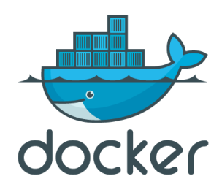

Container Software
Docker
  Well established and widely used
  Has a hub for container sharing
  Problematic with HPC (requires root access)
Singularity
  User friendly
  Designed for HPC
  Can interpret Docker contains + others
Notes:
There are two main options when starting to venture out to create containers.
I’m going to focus on Singularity containers because they integrate well with the HPC.
Creating a docker container is not that much different

Slide 96
Container Software
Docker
  Well established and widely used
  Has a hub for container sharing
  Problematic with HPC (requires root access)
Singularity
  User friendly
  Designed for HPC
  Can interpret Docker contains + others
Notes:
I’m going to focus on Singularity containers because they integrate well with the HPC.
Creating a docker container is not that much different

Slide 97
Containers – How do I obtain them?
TWO OPTIONS
a
b
Run a pre-made container
Build and run your own container

Slide 98
Containers – How do I obtain them?
TWO OPTIONS
a
b
Run a pre-made container
Build and run your own container

Slide 99
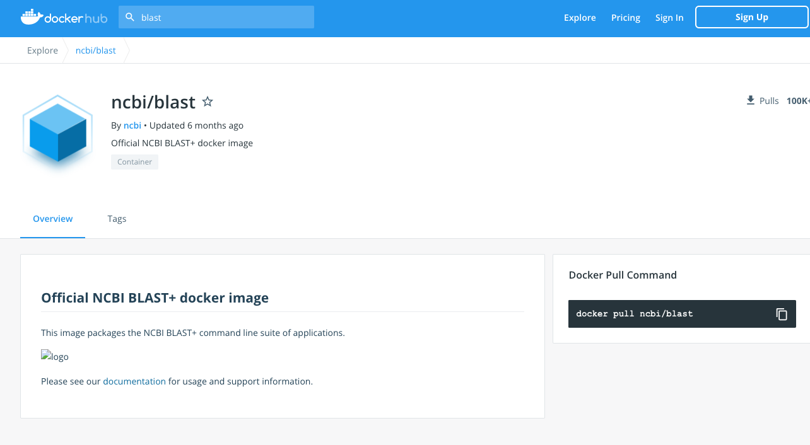
Using a Pre-Made Container
1. Find the container
  https://cloud.sylabs.io/library
  https://hub.docker.com/
  https://quay.io/
Notes:
First you need to locate the container.
Here are different hubs for containers that you can search
Quay is really nice for biology because it specifically has ‘biocontainers’ which contain a lot of biological software
For the example here, I searched for the blast software on docker hub

Slide 100
Using a Pre-Made Container
1. Find the container
  https://cloud.sylabs.io/library
  https://hub.docker.com/
  https://quay.io/
specifically has ‘biocontainers’
Notes:
First you need to locate the container.
Here are different hubs for containers that you can search
Quay is really nice for biology because it specifically has ‘biocontainers’ which contain a lot of biological software
For the example here, I searched for the blast software on docker hub

Slide 101
Using a Pre-Made Container
2. Download the container image
singularity pull docker://ncbi/blast:latest
Notes:
Even though we are using singularity, you can convert a docker image to a singularity image.
You first need to locate the container directory on the cite. Here it is marked as ncbi/blast
Singularity pull is the command you use

Slide 102
Using a Pre-Made Container
2. Download the container image
Location of container
singularity pull docker://ncbi/blast:latest
Notes:
Mark the location of the container. Here, we are using docker hub, so we tell singularity that this is a docker image that needs to be converted

Slide 103
Using a Pre-Made Container
Container directory
2. Download the container
Location of container
Container directory
singularity pull docker://ncbi/blast:latest
Notes:
Then mark the container directory

Slide 104
Using a Pre-Made Container
2. Download the container
Version history
Location of container
Container directory
Version number
singularity pull docker://ncbi/blast:latest
Notes:
Laslty, we give it the version number. This downloads the latest version of blast, but you can download other version by looking at the ‘tags’ on the webpage.

Slide 105
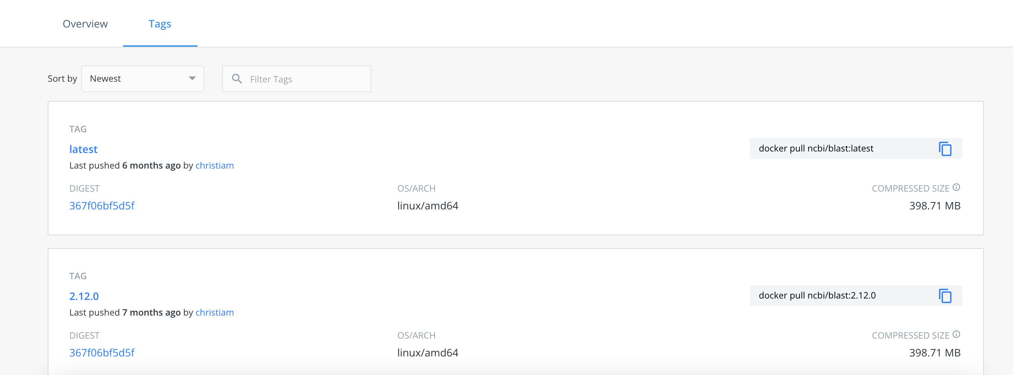
Using a Pre-Made Container
Version history
Version number
singularity pull docker://ncbi/blast:latest
Notes:
Laslty, we give it the version number. This downloads the latest version of blast, but you can download other version by looking at the ‘tags’ on the webpage.

Slide 106
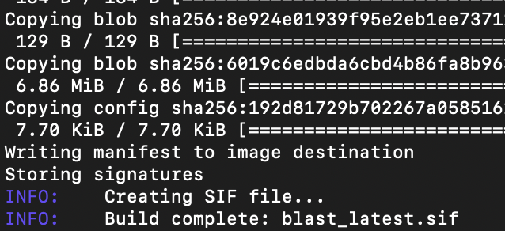
Using a Pre-Made Container
'Pull’ downloads the container and creates a .sif file
Notes:
After executing this command, you will see a lot of text pop up as it downloads the file information.
Finally you will see that it is creating the .sif file – which is a singularity container file.

Slide 107
Using a Pre-Made Container
'Pull’ downloads the container and creates a .sif file
You can point to this in your config file….more on this now
Notes:
Finally, once it is done, it will show the container file name: blast_latest.sif in this instance

Slide 108
Nextflow Configuration File

Slide 109
Nextflow Configuration File – What is it?
We have many things we’ve discussed
  Nextflow Process File (.nf)
  Singularity containers
  A host operating system with a certain number of cores, memory, etc
  A possible workflow manager (i.e. Slurm)

Slide 110
Nextflow Configuration File – What is it?
We have many things we’ve discussed
  Nextflow Process File (.nf)
  Singularity containers
  A host operating system with a certain number of cores, memory, etc
  A possible workflow manager (i.e. Slurm)
How does Nextflow manage all of this?

Slide 111
Nextflow Configuration File – What is it?
We have many things we’ve discussed
  Nextflow Process File (.nf)
  Singularity containers
  A host operating system with a certain number of cores, memory, etc
  A possible workflow manager (i.e. Slurm)
How does Nextflow manage all of this?
  Answer: through a nextflow.config file

Slide 112

Nextflow Configuration File – What is it?
Like a manager
Notes:
Acts a lot like a manager over your nextflow file, data, containers, and the computer hosting all of it.

Slide 113
Nextflow Configuration File – What is it?
Like a manager
Communicates between nextflow process file and the host computer
Notes:
So this is what looks at your nextflow file and says ‘okay, you want to do these things to these files and use these containers to do it. Alright, computer, I need you to do this in x-amount of time with these containers and this amount of memory and cpus.

Slide 114
Nextflow Configuration File – What is it?
A simple text file containing a set of properties
  Syntax : name = value
Notes:
It is really a simple text file, so it keeps the syntax of name = value

Slide 115
Nextflow Configuration File – What is it?
A simple text file containing a set of properties
  Syntax : name = value
Helps define:

Slide 116
Nextflow Configuration File – What is it?
A simple text file containing a set of properties
  Syntax : name = value
Helps define:
  Computer hardware – # CPUs, amount of memory, etc.
Notes:
The process directives allow for specification of the settings of the task execution. You can think of these as the default settings, as these can always be changed/specified in the process script.

Slide 117
Nextflow Configuration File – What is it?
A simple text file containing a set of properties
  Syntax : name = value
Helps define:
  Computer hardware – # CPUs, amount of memory, etc.
  Cluster Deployment – local vs. grid executor (like Slurm)
Notes:
The cluster deployment is a key feature of nextflow: allows you to decouple the workflow implementation from the actual execution platoform

Slide 118
Nextflow Configuration File – What is it?
A simple text file containing a set of properties
  Syntax : name = value
Helps define:
  Computer hardware – # CPUs, amount of memory, etc.
  Cluster Deployment – local vs. grid executor (like Slurm)
  Container Configuration – defines location of containers
Notes:
Configuration profiles is helpful if you are switching between computers a lot (like running on a local server vs the CHPC cluster)

Slide 119
Nextflow Configuration File – What is it?
A simple text file containing a set of properties
  Syntax : name = value
Helps define:
  Computer hardware – # CPUs, amount of memory, etc.
  Cluster Deployment – local vs. grid executor (like Slurm)
  Container Configuration – defines location of containers
  Volume Mounts – can specify EBS volumes for AWS batch storage
Notes:
Volume mounts are helpful if you use cloud computing. I don’t, so I will just leave it at that and won’t talk about it anymore.

Slide 120
Nextflow Configuration File – How to Build It
process {
}
Create your process function
Notes:
Here I’ll give you a basic idea of what these could look like. Remember: you can always expand on this and add more options.
Create a process function with open and closed curly brackets

Slide 121
Nextflow Configuration File – How to Build It
process {
executor=‘slurm’
}
Specify your executor
Notes:
You need to specify your executor if you are using a cluster. The type is specified by your cluster.
If you are using the CHPC, it is SLURM.
Other options include Kubernetes, Ignite, AWS Batch
If you are using a local server or your own computer, don’t put this line.
Again, what is really nice about this is that it allows your to parallelize your workflow.

Slide 122
Nextflow Configuration File – How to Build It
process {
executor=‘slurm’
withLabel: highcpu_mem {
cpus = 16
memory = 200
}
withLabel: lowcpu_mem {
cpus = 4
memory = 50
}
}
Specify cpu and memory
Notes:
Memory is in GB
Allows for flexibility in your settings

Slide 123
Nextflow Configuration File – How to Build It
process {
executor=‘slurm’
withLabel: highcpu_mem {
cpus = 16
memory = 200
}
withLabel: lowcpu_mem {
cpus = 4
memory = 50
}
withLabel: my_container {
container = ‘/some/path/containers/blast_latest.sif’
}
}
Specify location of container(s)

Slide 124
Nextflow Configuration File – How to Build It
process {
executor=‘slurm’
withLabel: highcpu_mem {
cpus = 16
memory = 200
}
withLabel: lowcpu_mem {
cpus = 4
memory = 50
}
withLabel: my_container {
container = ‘/some/path/containers/blast_latest.sif’
}
}
singularity {
enabled = true
}
Enable singularity
Notes:
Tell nextflow that you are using singularity containers. If you are using Docker, you can put that instead of singularity. They all are configured in the same manner.

Slide 125
Putting it all together

Slide 126
Putting it all together – how to organize files
Main Nextflow Directory
nextflow_process.nf
containers
nextflow.config
mycontainer.sif
anothercontainer.sif
bin
MyPythonScript.py
MyRScript.r
work

Slide 127
Putting it all together – how to organize files
Main Nextflow Directory
nextflow_process.nf
containers
nextflow.config
mycontainer.sif
anothercontainer.sif
bin
MyPythonScript.py
MyRScript.r
work
Notes:
Start out with some kind of head directory. This is the directory that is going to contain all of your nextflow stuff

Slide 128
Putting it all together – how to organize files
Main Nextflow Directory
nextflow_process.nf
containers
nextflow.config
mycontainer.sif
anothercontainer.sif
bin
MyPythonScript.py
MyRScript.r
work
Notes:
I like to put all of my nextflow .nf files within this directory

Slide 129
Putting it all together – how to organize files
Main Nextflow Directory
nextflow_process.nf
containers
nextflow.config
mycontainer.sif
anothercontainer.sif
bin
MyPythonScript.py
MyRScript.r
work
Notes:
I find it easier to create a directory of containers

Slide 130
Putting it all together – how to organize files
Main Nextflow Directory
nextflow_process.nf
containers
nextflow.config
mycontainer.sif
anothercontainer.sif
bin
MyPythonScript.py
MyRScript.r
work
Notes:
Keeping your configuration file here makes it easiest.
This is because nextflow automatically looks for a file called ‘nextflow.config’ in the directory you are running your nextflow file from

Slide 131
Putting it all together – how to organize files
Main Nextflow Directory
nextflow_process.nf
containers
nextflow.config
mycontainer.sif
anothercontainer.sif
bin
MyPythonScript.py
MyRScript.r
work
Notes:
optionally you can create a bin directory where you store any executable scripts.
If you do call on a script that you wrote, nextflow automatically looks for a bin container in this directory for that script.

Slide 132
Putting it all together – how to organize files
Main Nextflow Directory
nextflow_process.nf
containers
nextflow.config
mycontainer.sif
anothercontainer.sif
bin
MyPythonScript.py
MyRScript.r
work
Notes:
Lastly, nextflow, by default, places a workflow directory in the directory you run your .nf files
This is where all I/O happens
You can change this to be somewhere else if you want, such as a scratch directory. You can specify that in your configuration file

Slide 133
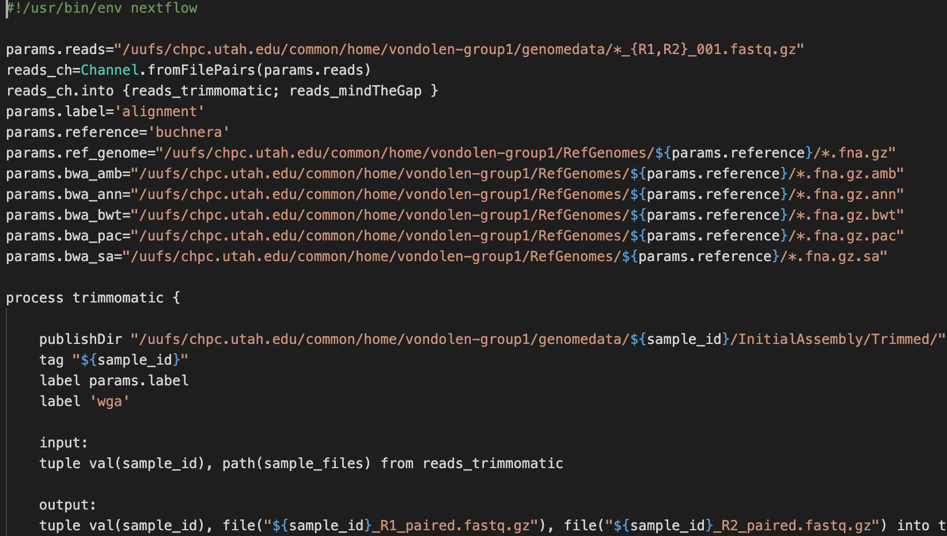
Putting it all together
wga-bwaCHPC.nf

Slide 134
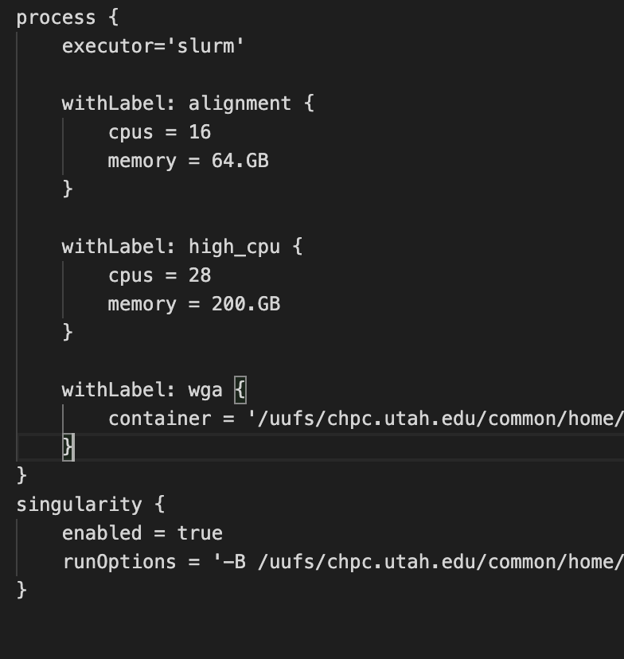
Putting it all together
Config file

Slide 135
Putting it all together – running Nextflow
From the command line:
Notes:
Once you have all your files organized, its as easy as saying ‘nextflow run this process file’
The ‘nextflow’ command is the location of the executable file
Here is also an example of me changing a parameter in the command line

Slide 136
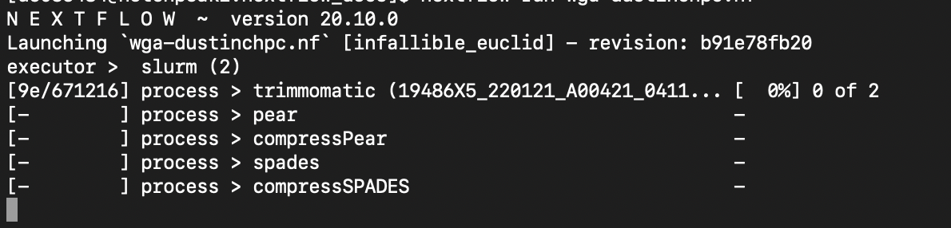
Putting it all together – running Nextflow
From the command line:
What happens:
Notes:
Here I only have one set of files running
This tells us a few important things:
where the work directory is (the majority of the I/O happens here)
what process is occurring
what file it is running
how much it has completed

Slide 137
Putting it all together – running Nextflow
From the command line:
What happens:
Notes:
Here I only have one set of files running
This tells us a few important things:
where the work directory is (the majority of the I/O happens here)
what process is occurring
what file it is running
how much it has completed

Slide 138
Putting it all together – running Nextflow
From the command line:
What happens:
Notes:
Here I only have one set of files running
This tells us a few important things:
where the work directory is (the majority of the I/O happens here)
what process is occurring
what file it is running
how much it has completed

Slide 139
Putting it all together – running Nextflow
From the command line:
What happens:
Notes:
Here I only have one set of files running
This tells us a few important things:
where the work directory is (the majority of the I/O happens here)
what process is occurring
what file it is running
how much it has completed

Slide 140
Putting it all together – running Nextflow
From the command line:
What happens:
How it handles batch systems:
Notes:
Here I only have one set of files running
This tells us a few important things:
where the work directory is (the majority of the I/O happens here)
what process is occurring
what file it is running
how much it has completed

Slide 141
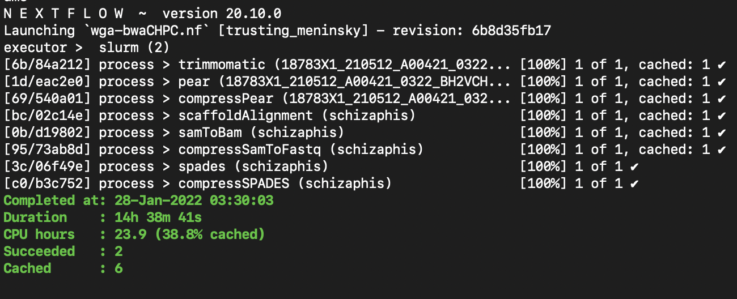
Putting it all together – running Nextflow
Notes:
This is what it looks like when its done running.

Slide 142
nf-core

Slide 143
What is nf-core?
A bit of history:
  Nextflow (now Seqera) was originally released in 2013
  Began primarily for bioinformatics work
  Most pipelines designed by individuals/labs and not shared
  2019: nf-core idea proposed
  nf-core is for community-developed pipelines
  2024: nf-core gains popularity
  Still primarily bioinformatics, but is gaining popularity in other domains

Slide 144

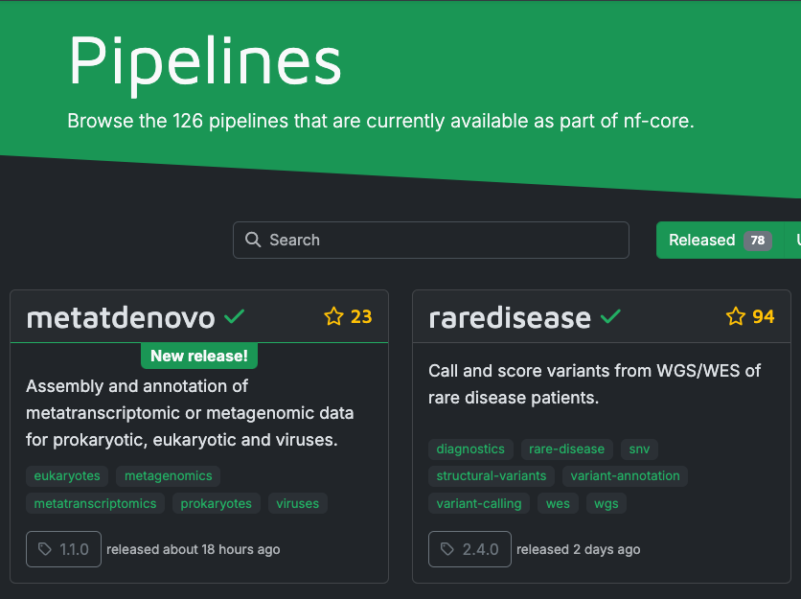
nf-core
nf-co.re
Notes:
Makes

Slide 145
nf-core
nf-co.re
Nextflow process file = nf-core pipeline
Nextflow process = module
Individual pipelines and individual modules can be installed
All works from the nextflow command line
Notes:
Makes

Slide 146
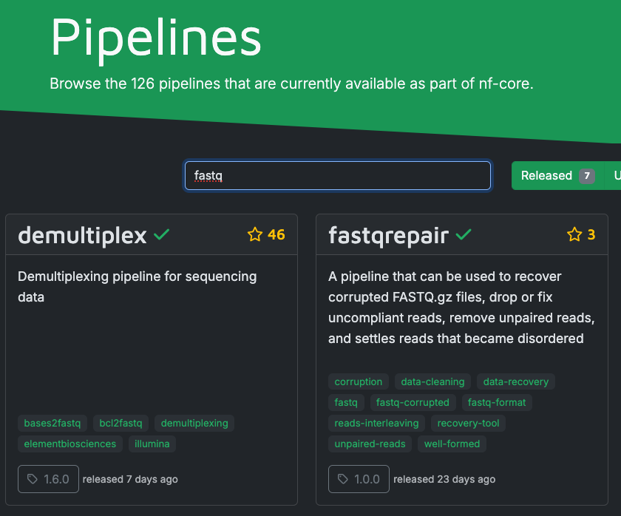
nf-core
Use search bar for kewords (i.e. fastq)
Notes:
Makes

Slide 147
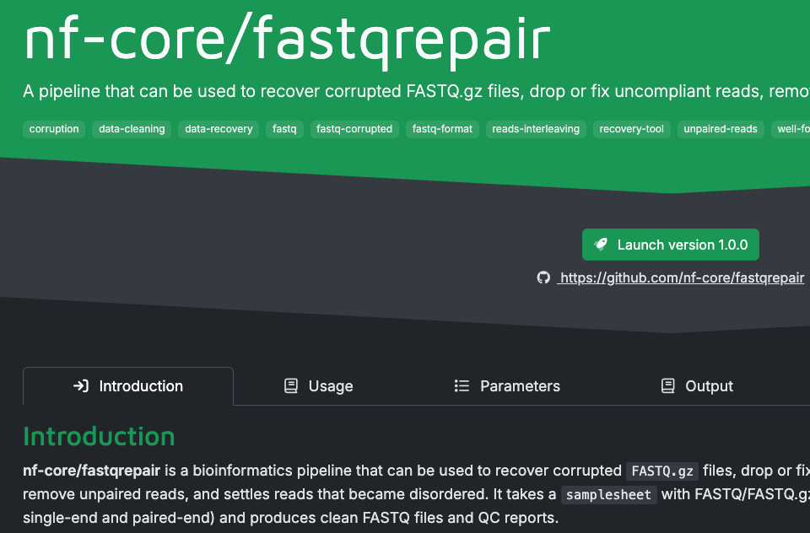
nf-core
Clicking on the pipeline provides more info
Top two things to look at:
  Usage
  Parameters
Notes:
Makes

Slide 148
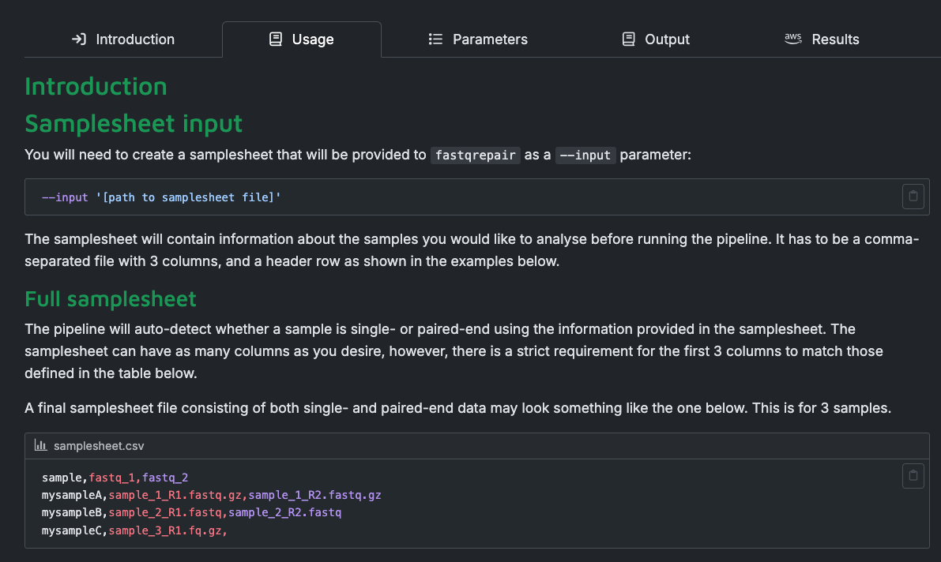
nf-core
Clicking on the pipeline provides more info
Top two things to look at:
  Usage
  Parameters
Notes:
Makes

Slide 149
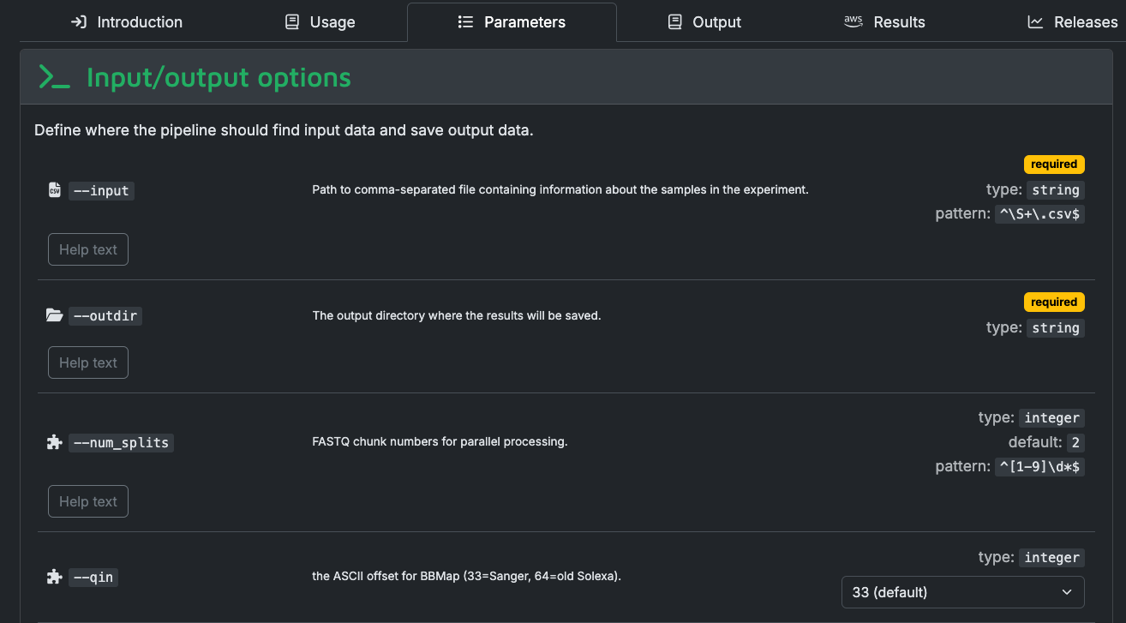
nf-core
Clicking on the pipeline provides more info
Top two things to look at:
  Usage
  Parameters
Notes:
Makes

Slide 150
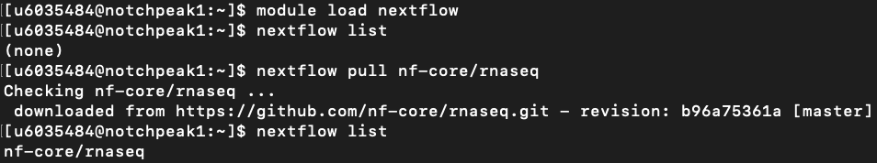
nf-core from the Command Line
List any nf-core pipelines downloaded by you
Download an nf-core pipeline
rnaseq pipeline returns as exisiting now

Slide 151
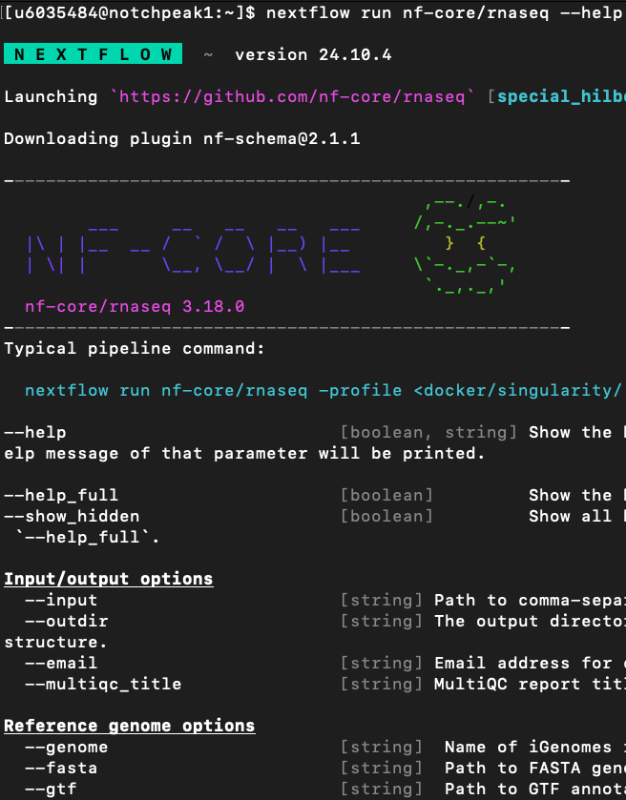
Return help information for pipeline
Example execution command
Parameter info here same as in Parameters section on nf-co.re

Slide 152
Lots of info and training out there!
YouTube Nextflow Foundational Training Workshop : https://www.youtube.com/watch?v=dbOKB3VRpuE
Nextflow online manual : https://www.nextflow.io/docs/latest/index.html
nf-core: https://nf-co.re/
Nextflow and nf-core both have Slacks to ask questions/get help: https://nextflow.slack.com/join/shared_invite/zt-2viwl0txy-FnMU~L7gAsZCAdutGc_00w#/shared-invite/email
  (or google ‘Nextflow Slack channel’)
Notes:
Nextflow has a 4-day training workshop that was recorded and uploaded to YouTube
Nextflow also has a helpful online manual
Lastly, if you want some examples of complete nextflow process files, along with an example configuration file and info for containrs, go to my GitHub repo.

Slide 153
Questions?
helpdesk@chpc.utah.edu

